Slide 1
New rectal cancer classification by NMF method Test: Korean data Validation: TCGA data
student. Yongmin LEE
College of Medicine,
Yonsei Univ.

Slide 2
Sample description
Korean rectal cancer data
230 patients.
s/p Neoadjuvant Tx.
including pCR and survival data

Slide 3
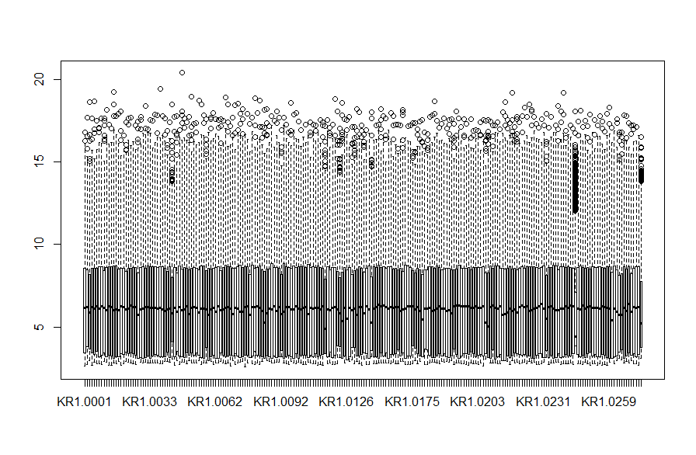

Slide 4
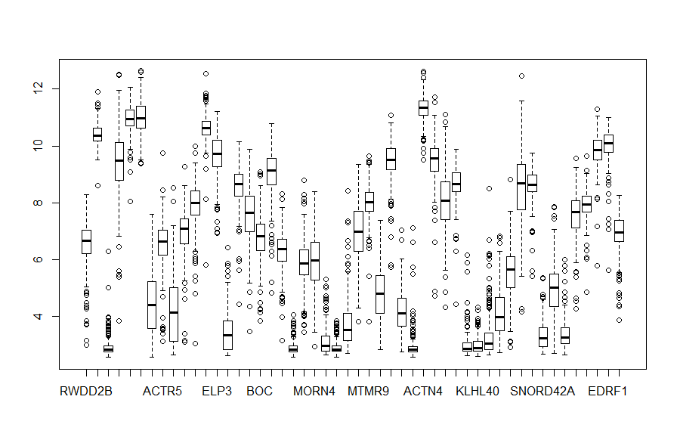
50 genes were chosen randomly.

Slide 5
Workflow
TCGA data
Korean rectal cancer cohort
NMF
Find optimal rank
PAM
Identify cluster identifying gene sets
Find metagenes
Validation: NTP
Perform NTP with novel gene sets and TCGA rectal cancer data
Survival analysis
Select significant genes
n=230

Slide 6
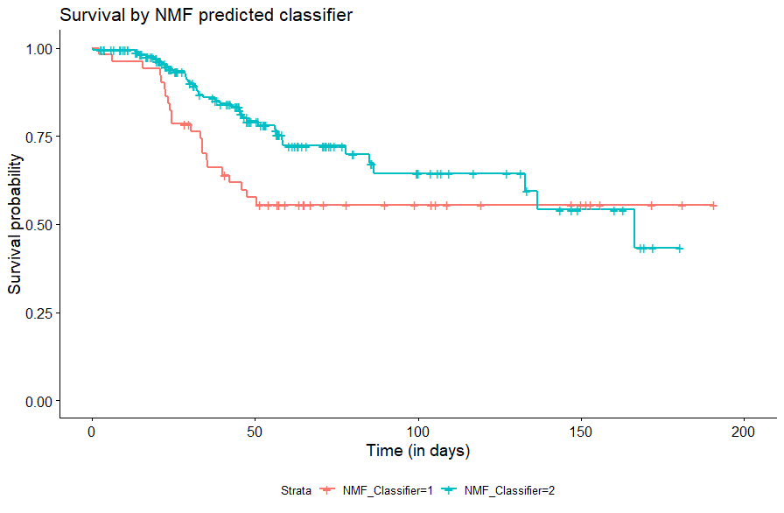
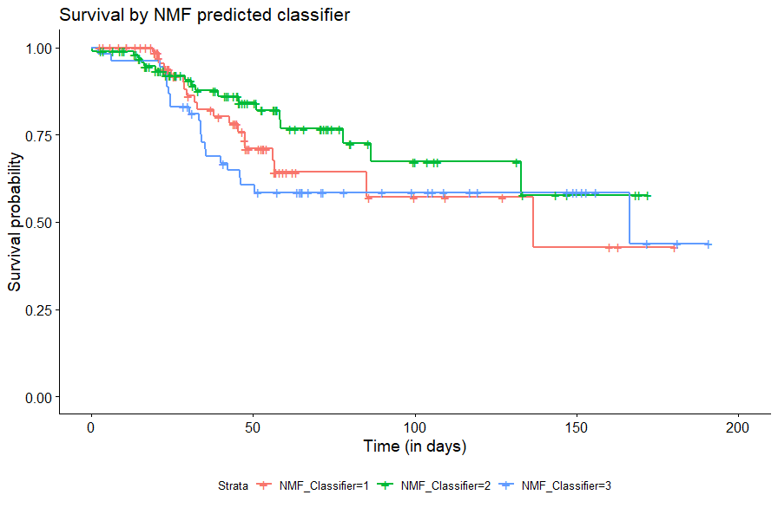
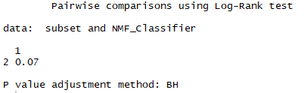
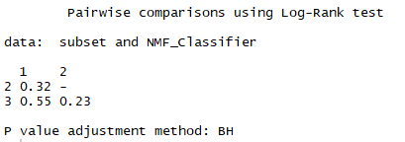
Rank = 2
Rank = 3
Not Significant!

Slide 7
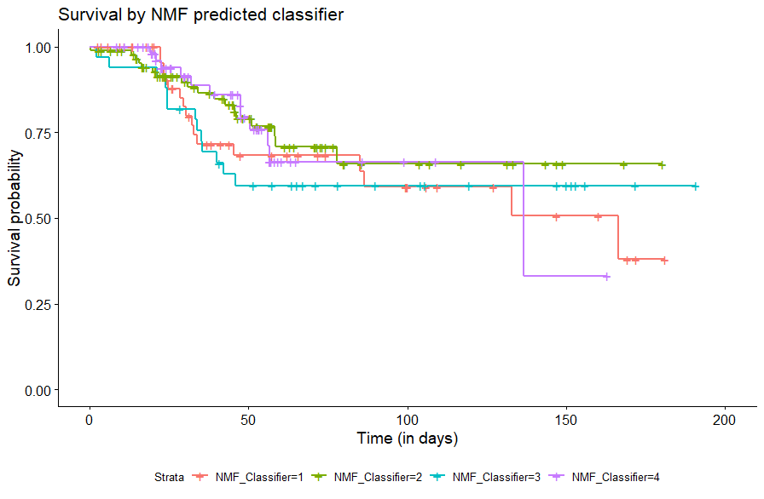
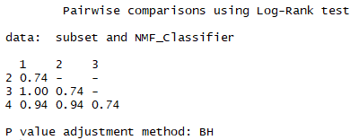
Rank = 4
Not Significant!

Slide 8
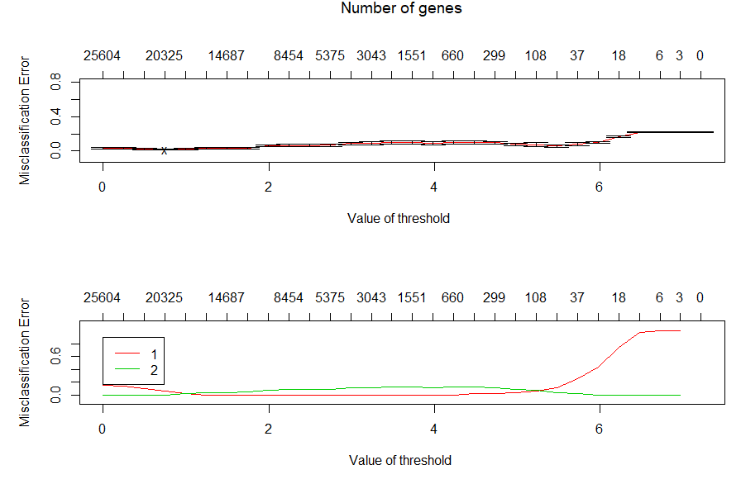
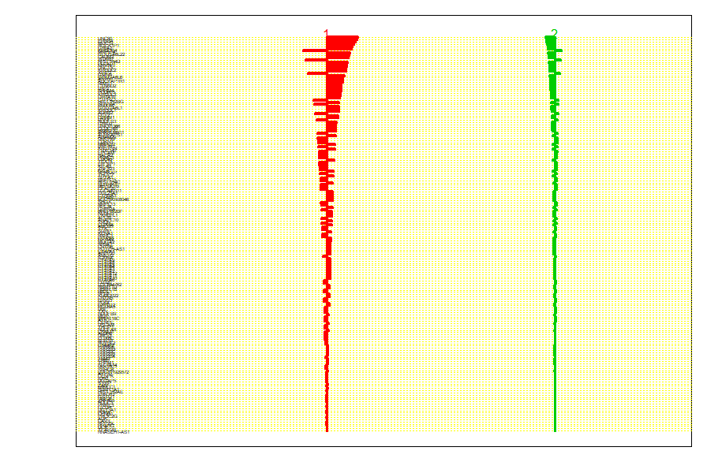
Rank = 2
Notes:
Threshold = 5.0으로 세팅

Slide 9
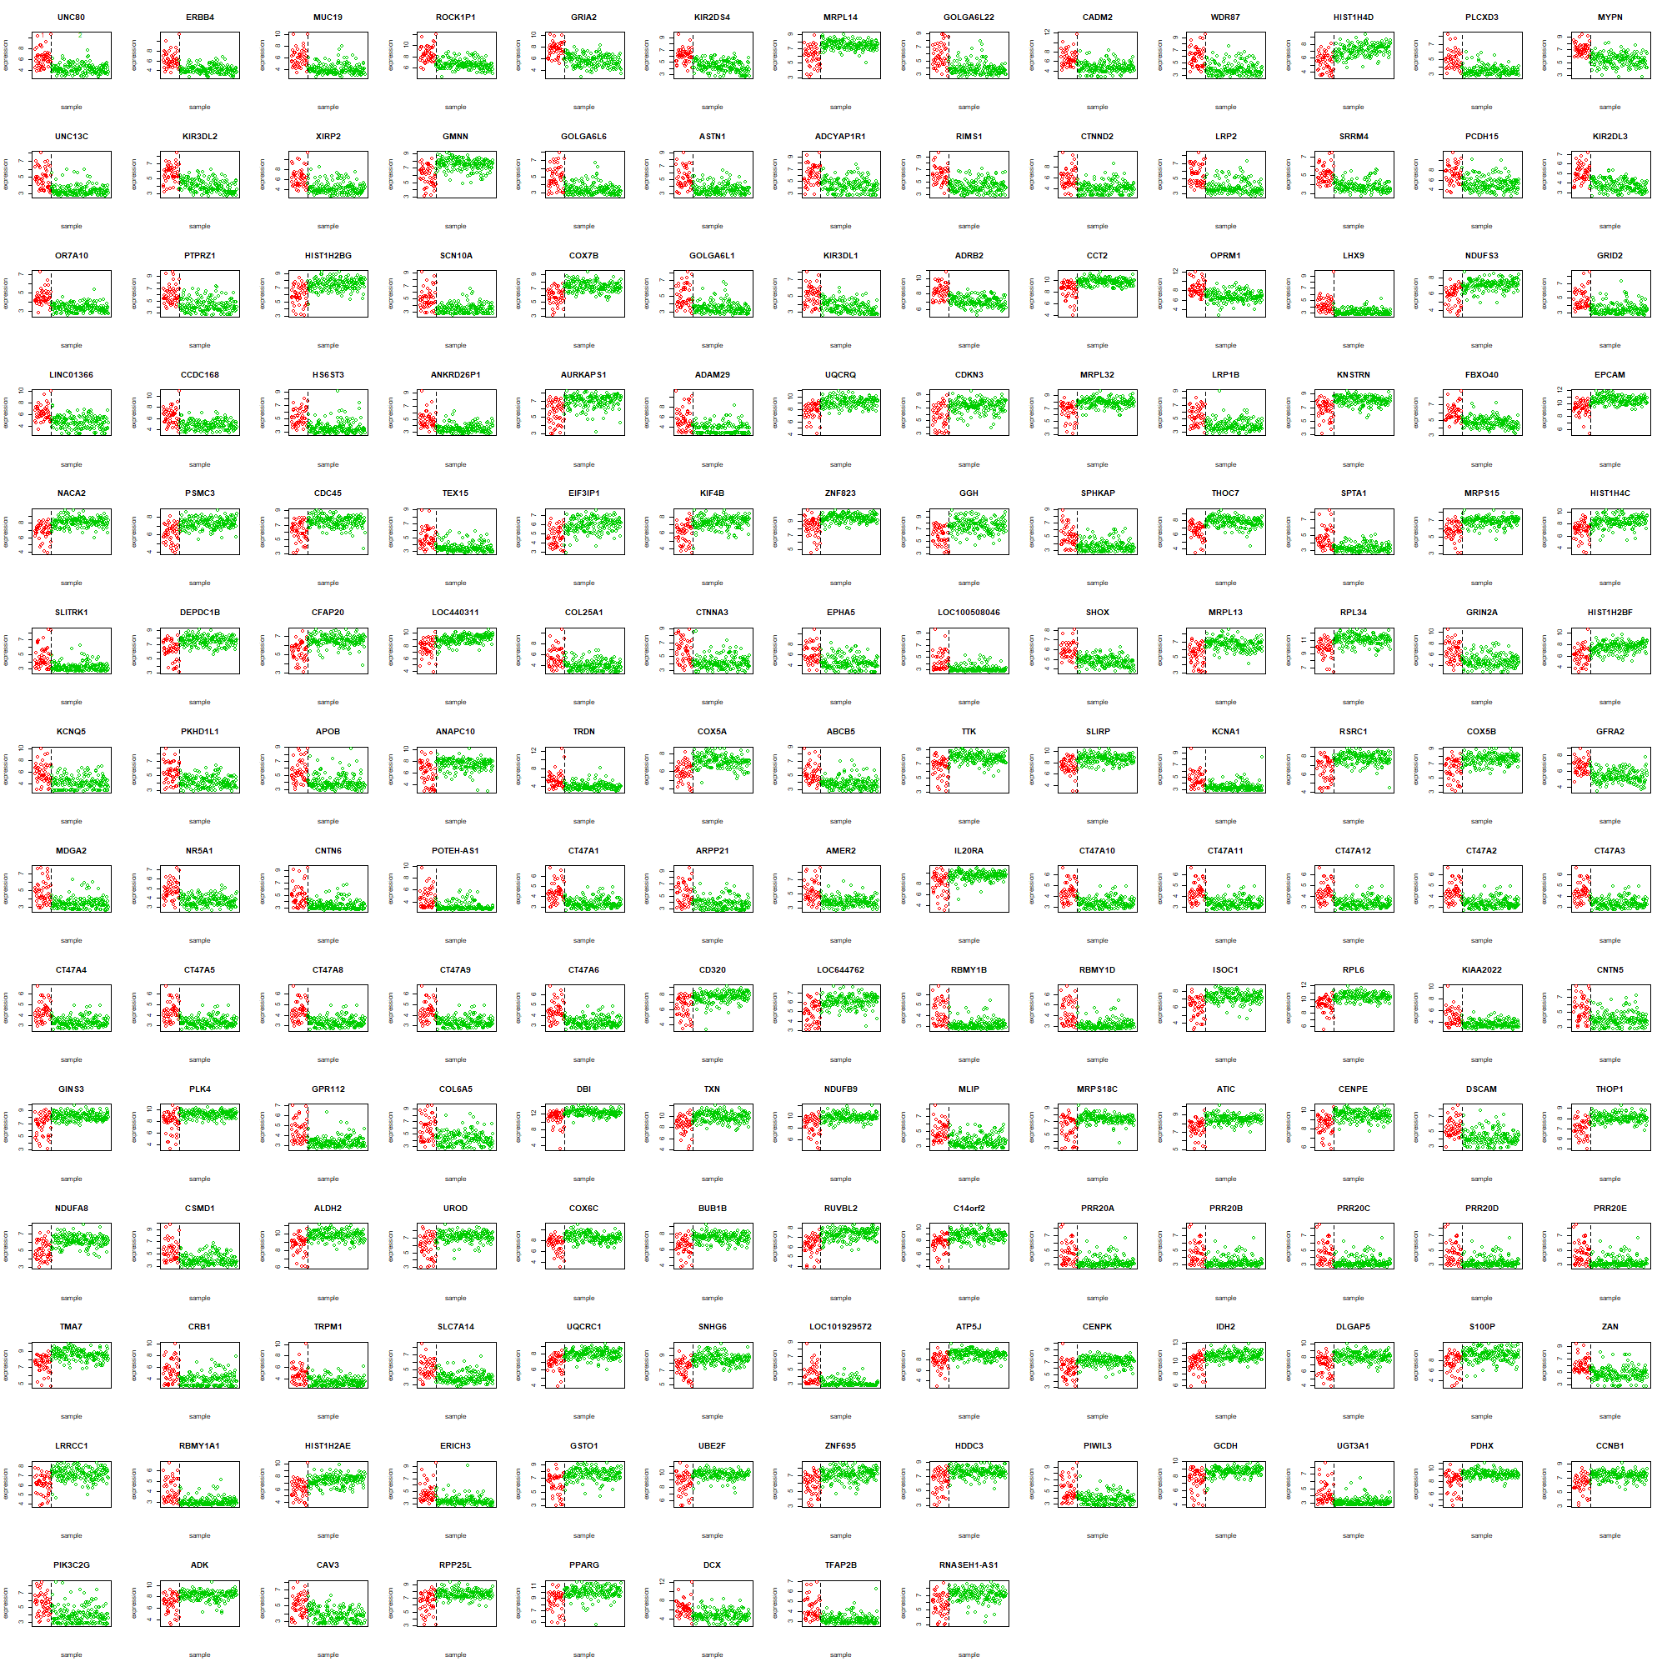
Rank = 2

Slide 10
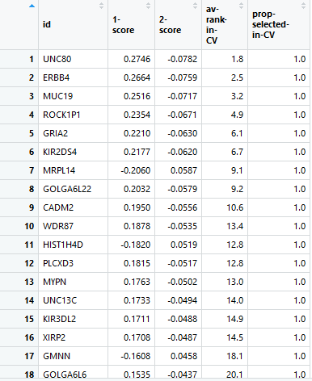
Rank = 2

Slide 11
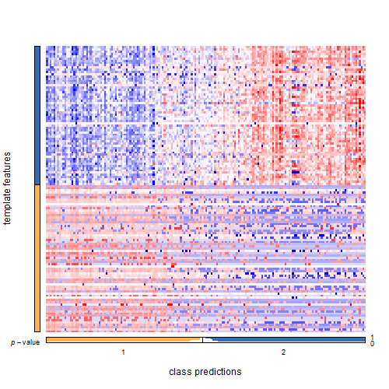
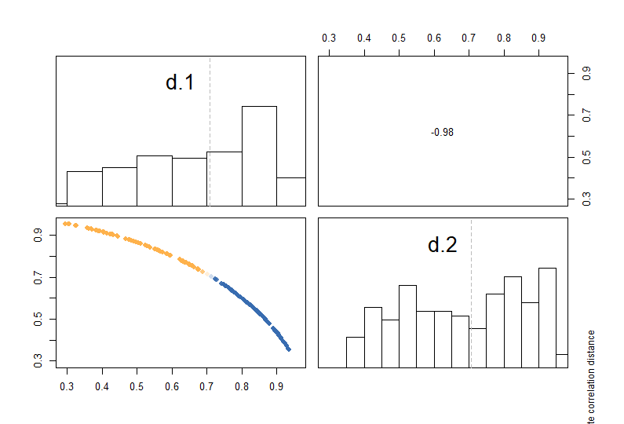
Validation with TCGA rectal cancer data
Rank = 2

Slide 12
여기까지

Slide 13
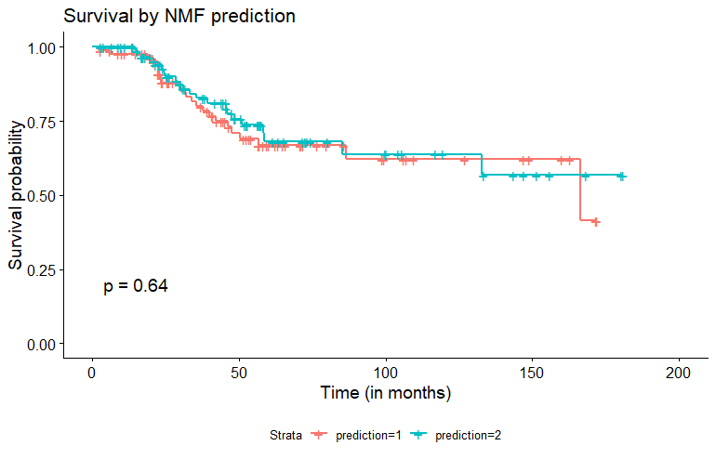

Validation with Korean rectal cancer data
Rank = 2

